Slide 1

Project Title - Seasonal Agriculture Performance Analysis
Student Name :NAG ADITYA REDBOINA
College Name- Koneru Lakshmaiah Education Foundation (KL University)
AICTE STU ID: STU6633423b4b75c1714635323

Slide 2

PROBLEM STATEMENT
Agricultural activities are influenced by seasonal variations in environmental conditions, farming practices, resource availability and market conditions. As a result, agricultural performance may differ from one season to another. However, raw agricultural data does not clearly explain how agricultural performance changes across seasons or what patterns can be observed in different seasonal conditions. The problem is to analyze the given agricultural dataset and investigate seasonal differences in agricultural performance by identifying meaningful patterns, trends, relationships and variations within the available data.

Slide 3
Project Description
Seasonal Agriculture Performance Analysis is a data analytics project that analyzes agricultural activities across different seasons, geographical regions, crops, farming practices, environmental conditions, resource usage, and economic outcomes. The project aims to identify meaningful seasonal patterns, trends, relationships, and variations in agricultural performance.
The analysis involves exploring and cleaning the agricultural dataset, comparing crop yield and profitability across Kharif, Rabi, and Zaid seasons, and examining differences across crops, states, districts, and irrigation methods. Environmental factors such as rainfall, temperature, humidity, and soil moisture, along with resource usage and irrigation practices, are analyzed to understand their relationship with agricultural outcomes.
Various Python data analysis, statistical, and visualization techniques are used to present the findings clearly. The project concludes with evidence-based insights and recommendations that can support better seasonal agricultural planning, resource management, and identification of areas requiring further investigation.
This project provides practical experience in data cleaning, exploratory data analysis (EDA), statistical analysis, data visualization, interpretation of results, and data-driven decision-making using Python Google Colab .

Slide 4

WHO ARE THE END USERS?
Farmers – To understand seasonal crop performance, yield, resource usage, and profitability.
Agricultural Planners – To support better seasonal crop and resource planning.
Agricultural Departments & Government Agencies – To identify regional and seasonal patterns for evidence-based planning.
Agricultural Consultants – To provide data-driven recommendations on crops, irrigation, and farming practices.
Researchers & Data Analysts – To study relationships between environmental conditions and agricultural outcomes.
Agribusiness & Supply Chain Stakeholders – To understand crop production and economic performance across seasons and regions.

Slide 5

Technology Used
Python – Core programming language for data analysis.
Pandas – Data cleaning, manipulation, and analysis.
NumPy – Numerical computations and data processing.
Matplotlib – Creating charts and visualizations.
SciPy – Statistical analysis and hypothesis testing.
Google Colab – Cloud-based environment for developing and running the project.

Slide 6
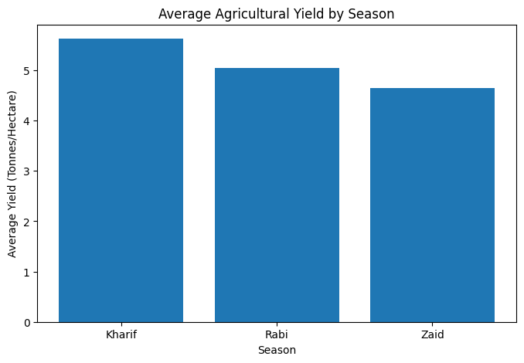
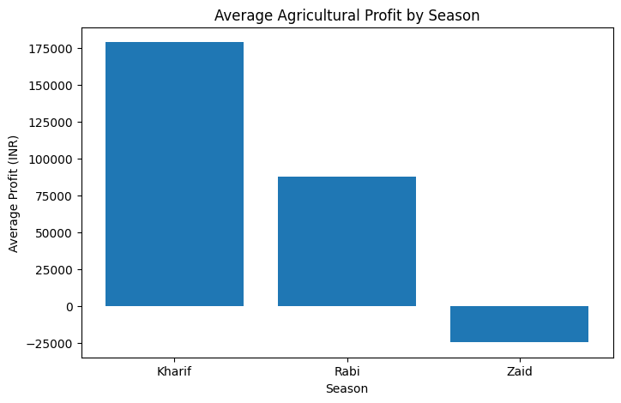
RESULTS

Slide 7
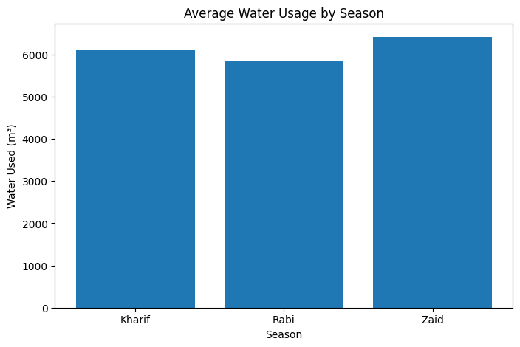
RESULTS

Slide 8
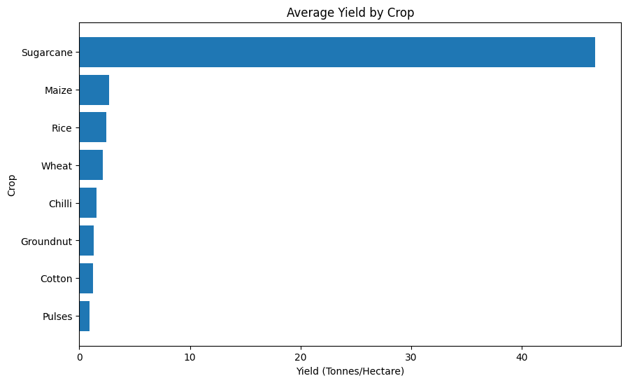
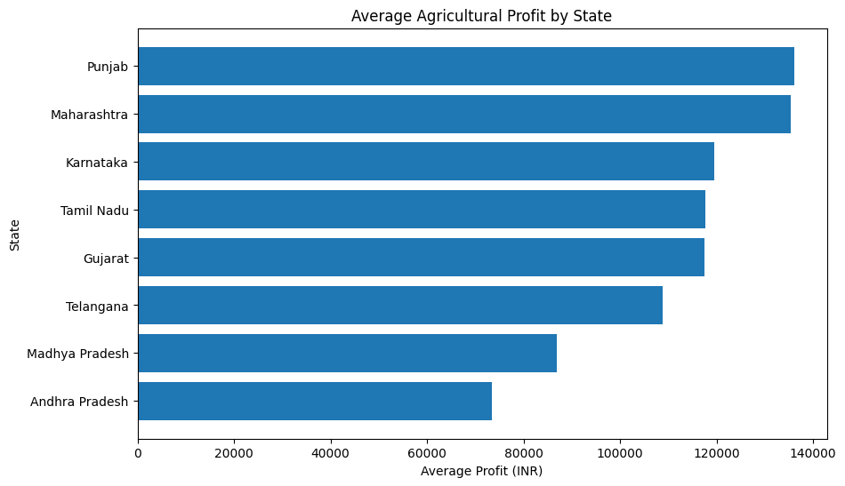
RESULTS

Slide 9
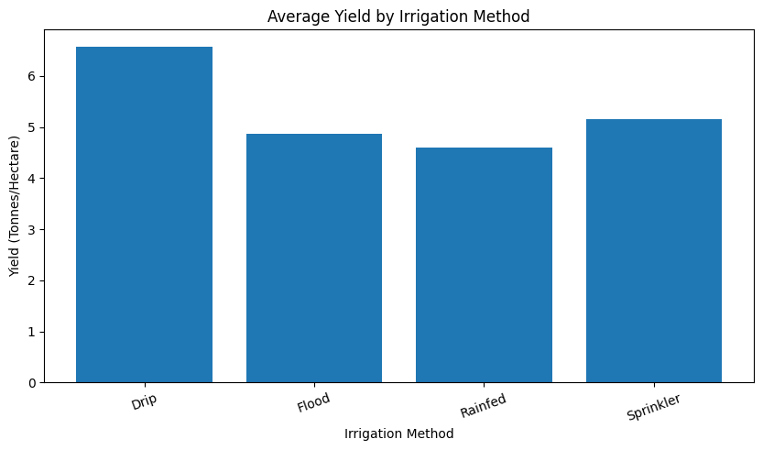
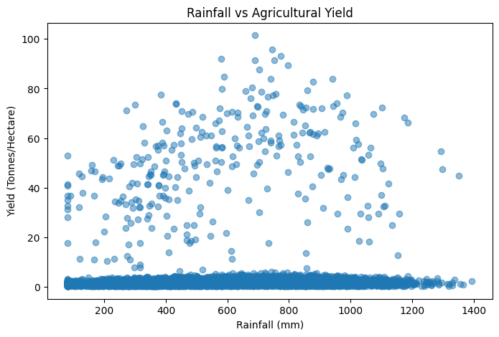
RESULTS

Slide 10
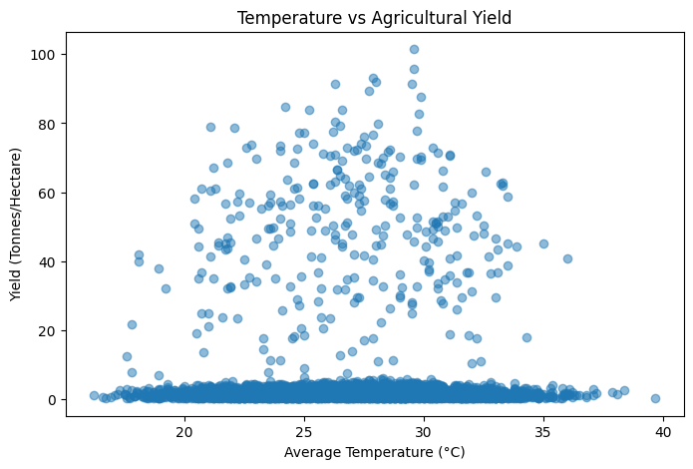
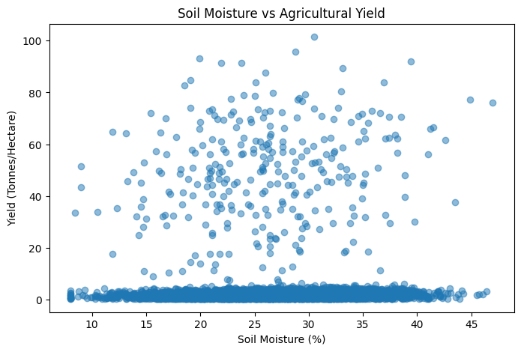
RESULTS

Slide 11
Future scope
Predictive Analysis – Develop machine learning models to predict crop yield and profitability for different seasons.
Weather Forecast Integration – Incorporate real-time and historical weather data to improve seasonal predictions.
Crop Recommendation System – Recommend suitable crops based on season, soil conditions, rainfall, and expected profitability.
Smart Irrigation – Develop data-driven irrigation recommendations to improve water efficiency.
Real-Time Monitoring – Integrate IoT sensors for monitoring soil moisture, temperature, and other field conditions.
Regional Planning – Extend the analysis to more regions and historical years for broader agricultural insights.
Interactive Dashboard – Build a dashboard using tools such as Power BI or Tableau for easier decision-making.

Slide 12
GitHub Link
https://github.com/Aditya79RN/VIOS---Major-Project---Seasonal-Agriculture-Performance-Analysis.git
Google Colab Link https://colab.research.google.com/drive/1eonGAJrgs9QIVmJWumDx9n3jnfekroCH?usp=sharing

Slide 13
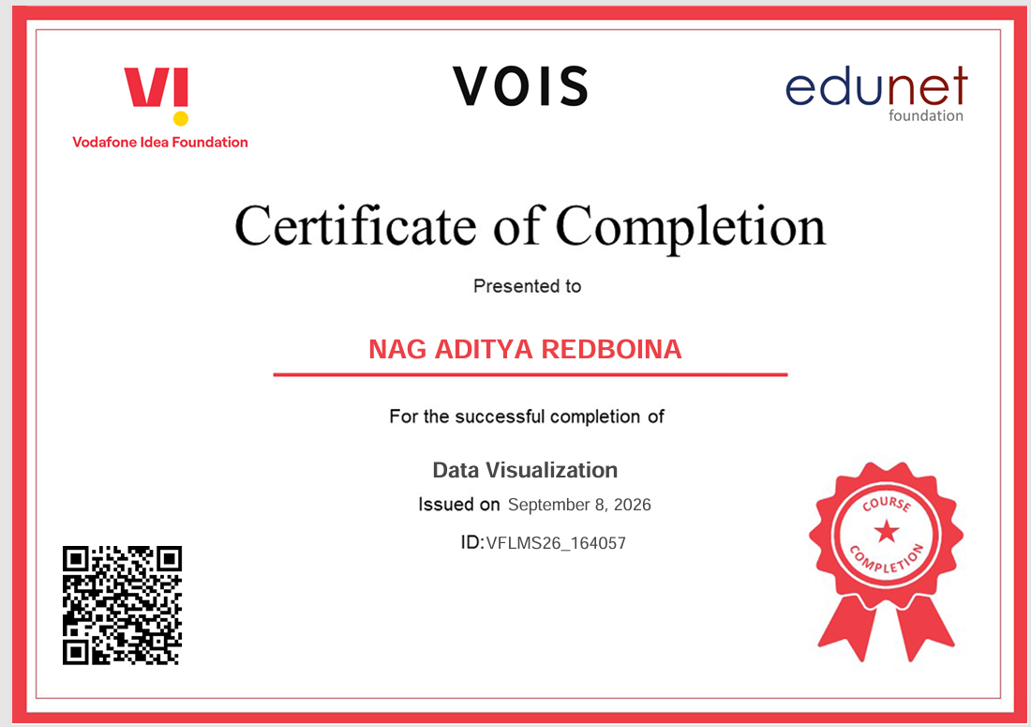
VOIS Course completion certificate - Course name- Data Visualization

Slide 14
Thank you
.
.

